Slide 1

USER MANUAL
REPORT AUTOMATION
V 1.01
September - 2022

Slide 2
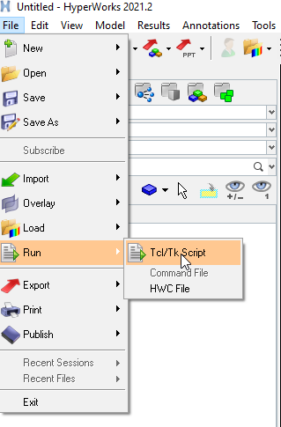
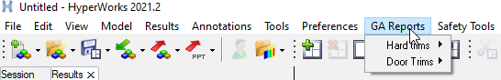
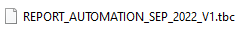
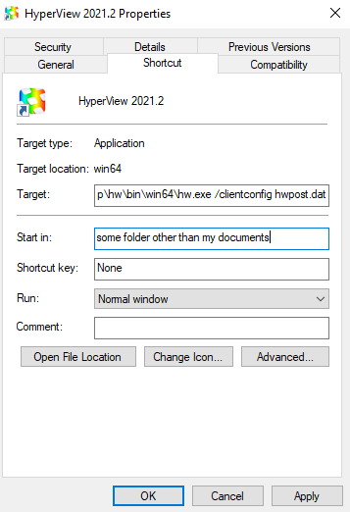
1.0.0 Launching the Automation.
1.0.1 Launching the TBC file.
User can click the menu bar on file ->Run->Tcl/Tk script . At this point an explorer window shall pop up. Please locate the tbc file at
The location you have placed it. The tbc file may be kept at any location. But please avoid network locations.
There are two options to launch the script. Option 1 and 2. With Option 2 , User can launch the automation directly from menu bar
On Option GA Reports ( Currently Option 2 is not activated).
Option 1
Option 2
1.0.2 Status of Hyper view Session.
A New Hyper view window is mandatory to run the Automation. Clearing the Data on an existing window with File->New->Session to launch the automation is not advised . Please do open a new hyper view window to launch the automation.
1.0.3 GA Hyper works installation issue.
Please create a shortcut for your Hyper works applications on desktop. For Hyper view, Hyper mesh etc. . If your start in directory is set to my documents or one drive . This will cause the applications to slow down ,due to upload process happening every time any changes
Are applied to applications. It is a general guideline ,This is not related to automations but if not done it would eventually slow down automations and general hyper works performance.
Right click on the shortcut icon of Hypermesh / Hyperview.
Please change this path to some location i

Slide 3
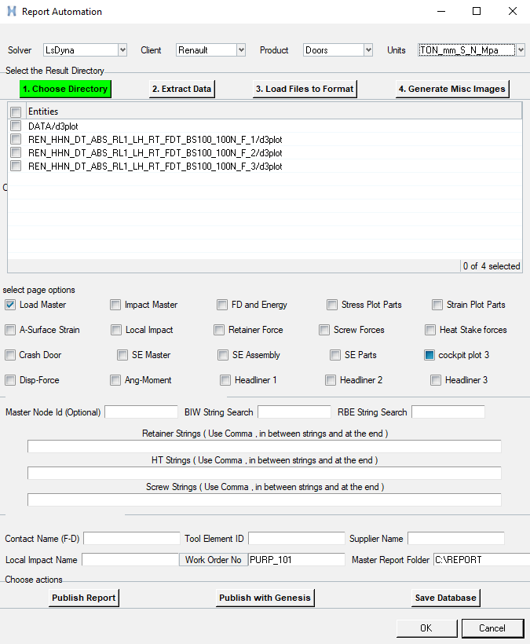
1.1.0 User Interface of Automation.
Project ,Product , solver and Unit selector area
Files, Data Extract ,Format and Non Plot image selector area
Files selector area.
Format selection Area
Deviation entry ,Additional connector data input area
Work Order, Report location and deviation area
Publish area
1.1.1 User Interface and Automation is written in TCL/TK 8.3.
The user interface and automation is written in TCL/TK 8.3.2 . It is written first with TCL version 8.5.9 and is later back ported to 8.3 to meet the encryption Requirements. The TCL files are converted to bytecode format. As direct encryption is not possible , A practical approach that’s possible is deployed. Converting back Bytecodes to tcl files is extremely difficult if not impossible.
TCLPro is available for free download at https://www.tcl.tk/software/tclpro/eval/
1.1.2 User Interface compatibility.
The user interface and automation is compatible with Altair 2021 and Altair 2022 versions. Please make sure you are using the correct version of Hyperworks to launch the automation. It is also compatible with the new hyperworks interface , however at present extensive testing on the new Hyperworks interface is not Carried out. Should you find any issues – Please contact the methodology department.
1.1.3 System Requirements.
The Automation currently supports windows 10 and 11. Linux support is unavailable for release1.
Recommended hardware – 32 GB RAM- 3200+ MHZ , intel 8th gen core i7, NVidia Quadro M series GPU, and SSD storage.
(The automations should perform reasonably well with similar AMD hardware)
The automations should work in ancient systems but the performance will be severely limited and could crash the system when multiple
Result files are loaded.

Slide 4
1.2.0 Project ,Product , solver and Unit selector area
SOLVER SELECTOR
CLIENT SELECTOR
PRODUCT SELECTOR
UNIT SELECTOR
1.2.1 Solver Selector.
Select the appropriate solver from the drop down list. Currently supported solvers are Abaqus implicit , Abaqus Explicit , Pamcrash and LsDyna. There are many dependencies associated with this selection. So please make correct selections.
1.2.2 Client Selector.
Select the appropriate solver from the drop down list. If certain client seems to be unavailable in the list, Please select Any.
1.2.3 Product Selector.
Select the appropriate Product choice from the drop down list. Currently supported Products are Doors and Hard trims. However if Generic page formats are chosen , There shouldn't be any issues running the automation for any product.
An Example is – If user wish to generate stress plots of independent parts for a cockpit , Please select those page options in the user interface of the automation.
1.2.4 Unit System Selector.
Select the appropriate Unit System from the drop down list. Currently supported Unit systems are Ton-mm-S-N-Mpa and Kg-mm-Ms-KN-GPa. If you need another unit system please inform the methodology department in advance , at the start of the project . If support for unit system is not added, It is possible to use the replace all tool in PowerPoint to Swap a particular unit with the one of your choice.
Unit system reference table
MASS | LENGTH | TIME | FORCE | STRESS | ENERGY | DENSITY | YOUNG's | GRAVITY
kg | m | s | N | Pa | J | 7.83E+03 | 2.07E+11 | 9.806
kg | cm | s | 1.0e-02 N |  |  | 7.83E-03 | 2.07E+09 | 9.81E+02
kg | cm | ms | 1.0e+04 N |  |  | 7.83E-03 | 2.07E+03 | 9.81E-04
kg | cm | us | 1.0e+10 N |  |  | 7.83E-03 | 2.07E-03 | 9.81E-10
kg | mm | ms | kN | GPa | kN-mm | 7.83E-06 | 2.07E+02 | 9.81E-03
g | cm | s | dyne | dyne/cm² | erg | 7.83E+00 | 2.07E+12 | 9.81E+02
g | cm | us | 1.0e+07 N | Mbar | 1.0e+07 Ncm | 7.83E+00 | 2.07E+00 | 9.81E-10
g | mm | s | 1.0e-06 N | Pa |  | 7.83E-03 | 2.07E+11 | 9.81E+03
g | mm | ms | N | MPa | N-mm | 7.83E-03 | 2.07E+05 | 9.81E-03
ton | mm | s | N | MPa | N-mm | 7.83E-09 | 2.07E+05 | 9.81E+03
kgf-s²/mm | mm | s | kgf | kgf/mm² | kgf-mm | 7.98E-10 | 2.11E+04 | 9.81E+03
kg | mm | s | mN | 1.0e+03 Pa |  | 7.83E-06 | 2.07E+08 | 9.81E+03
g | cm | ms | 1.0e+1 N |  |  | 7.83E+00 | 2.07E+06 | 9.81E-04

Slide 5
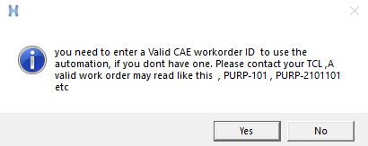
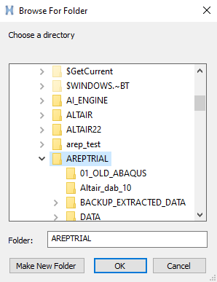
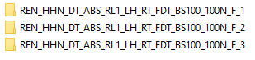
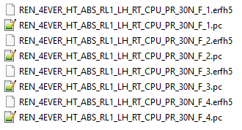
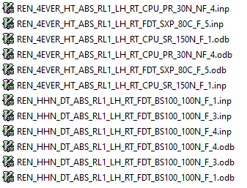
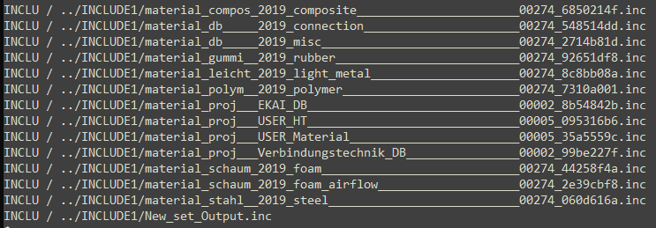
1.3.0 Files selector, Data selector , load files and Generate Non Plot switch.
DIRECTORY SELECTOR SWITCH
EXCTRACT DATA SWITCH
LOAD FILES TO FORMAT SWITCH
GENERATE NON PLOT SWITCH
1.3.1 Choose Directory.
Select the folder where you have kept the result files and input files with this switch. Always keep the files in SSD. Please do not choose the folders on network or hard disk . This will result in a very slow loading process. This has nothing to do with the automation. It’s a general guideline.
In order to load the files , Entry of a valid Work order number is mandatory. If you Don’t have a work order number, Please contact the TCL. You can enter a work order ID that you will create later as well. But please do make sure that the work order entered is valid. This gets written to the log files. And during tracking process it shouldn't happen that the work order id is invalid.
1.3.2 What to select.
Once you have entered a valid work order number the switch will be active . Click on the switch and Navigate to the folder where you have the results and click On it . Now the result files should appear at files selector area.
User can choose the report files that they intend to make report with . For LS-Dyna the automation shall publish the folder names . User need to select the folders that they need to Load for Ls-Dyna.
Example for Dyna Results.
Each folder has Dyna input and Result files.
So please select the folder once step above this.
Example for PamCrash Results.
The master folder has PC files and erfh5 files.
Please note:- DSY and THP files are not supported.
Example for Abaqus Results.
The master folder has inp and ODB files.
1.3.3 Mandatory Requirements.
It is mandatory to have the corresponding input files master present at the result folder. You may have your own include structure formats. But please make sure that the master input files can read all the include files if opened in hyper mesh through a normal procedure.
An example of Pamcrash include format, to read the include files one folder up the structure is given below.
INCLU / ../INCLUDE1/

Slide 6
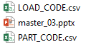
1.4.0 File and Folder Naming.
1.4.1 Naming Terminology.
The naming terminology is explained below. It is very similar to the existing methodology . It is standardized little deeper.
In case the supplier or engineer did not follow the naming protocols, The output files and input master files can be renamed to reflect
Methodology before automation use.
REN_HHN_DT_ABS_RL1_LH_RT_FDT_BS50_10N_F_1
REN _ HHN _ DT _ ABS _ RL1 _ LH _ RT _ FDT _ BS50 _ 10N _ F _ 1
Client
code
Project
code
Product
code
Solver
code
Stage
code
Side
code
Temp
code
Area
code
Load
code
Load
value
Func
code
Load
Pos
1.4.2 Report Folder and master PowerPoint file.
You will find at every installation location ,The below given files. The master file is a Power point file of Grupo Antolin report template.
You can use any PowerPoint file instead. An example is you can rename a file to master_03 and keep at C:\REPORT folder. The automation will append the slides to this master file. But it is recommended that the given file is used to avoid technical issues.
Methodology will not provide support for PowerPoint master files you have chosen.
1.4.3 Load Code and Part code CSV files.
It will be responsibility of the CAE department to update and maintain these files. The CAE department can choose the Client , product and area code of their choice. Make sure there are no spaces in between words . Use an underscore wherever you would like to separate words .
The area code file and Part code files are to be in CSV format. Please do check the CSV file in a text editor also once you have done updating with Microsoft Excel or a similar tool. Please make sure there are no spaces in the file. This can happen due to differences in encoding.
Part Code File
Area Code File
CLIENT | PRODUCT | CODE | AREA
REN | Hard_Trim | BDT | Back_Door_Trim
REN | Hard_Trim | BDU | Back_Door_Upper_Trim
REN | Hard_Trim | FKP | Front_Kicking_Plate
REN | Hard_Trim | ALU | A_Pillar_Upper
REN | Hard_Trim | APL | A_Pillar_Lower
REN | Hard_Trim | BPU | B_Pillar_Upper
REN | Hard_Trim | BPL | B_Pillar_Lower
REN | Hard_Trim | CPU | C_Pillar_Upper
REN | Hard_Trim | CPL | C_Pillar_Lower
REN | Hard_Trim | FKP | Front_Kicking_Plate
REN | Hard_Trim | RKP | Rear_Kicking_Plate
REN | Hard_Trim | TKP | Trunk_Kicking_Plate
REN | Hard_Trim | BPR | B_Pillar_Ramp
REN | Hard_Trim | CPR | C_Pillar_Ramp
REN | Door_Trim | FDT | Front_Door_Trim
REN | Door_Trim | RDT | Rear_Door_Trim
REN | Door_Trim | MPT | Map_Pocket
REN | Door_Trim | BLT | Belt_Line
REN | Door_Trim | PCP | PullCup
REN | Door_Trim | HT | Hard_Trim
REN | Door_Trim | DT | Door_trim
CLIENT | CODE | AREA | LIMIT | FORCE | TOOL_DESCRIPTION
REN | PR30 | Percieved_Rigidity | 1 | 30 | 30mm_Disk
REN | PR50 | Percieved_Rigidity | 1 | 50 | 30mm_Disk
REN | PR | Percieved_Rigidity | 1 | 50 | 30mm_Disk
REN | BS100 | Bending_Strength | 1 | 180 | 12mm_Disk
REN | BS180 | Bending_Strength | 1 | 180 | 12mm_Disk
REN | BS500 | Bending_Strength | 1 | 500 | 50mm_Disk
REN | BS800 | Bending_Strength | 1 | 800 | 40mmX80mm_Plate
REN | BS1000 | Bending_Strength | 1 | 1000 | 40mmX80mm_Plate
REN | BS | Buckling_Strength | 1 | 1000 | 40mmX80mm_Plate
REN | SR | Slipping_Resistance | 1 | 150 | 30mm_Disk
REN | ARS | ArmRest_Stiffness | 1 | 500 | 40mmX80mm_Plate
REN | GHT | GrabHandle_Torsion | 1 | 10 | Cylinder
REN | THM | TibHandle_MisUse | 1 | 250 | Cylinder
REN | THF | Thorax_Impact_Frontal | 1 | 5 | Dummy Form
REN | THR | Thorax_Impact_Rearward | 1 | 5 | Dummy Form
REN | ABF | Abdomen_Impact_Frontal | 1 | 5 | Dummy Form
REN | ABR | Abdomen_Impact_Rearward | 1 | 5 | Dummy Form
REN | PLF | Pelvis_Impact_Frontal | 1 | 5 | Dummy Form
REN | PLR | Pelvis_Impact_Rearward | 1 | 5 | Dummy Form
REN | SHF | Shoulder_Impact_Frontal | 1 | 5 | Dummy Form
REN | SHR | Shoulder_Impact_Rearward | 1 | 5 | Dummy Form
REN | SXP | Sun_Exposure | 3 | 80C | Thermal_Load

Slide 7
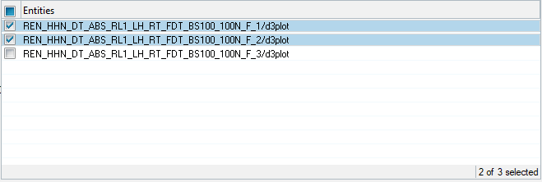
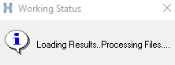
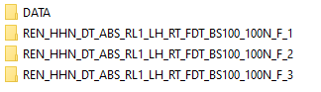
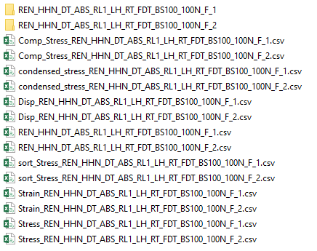
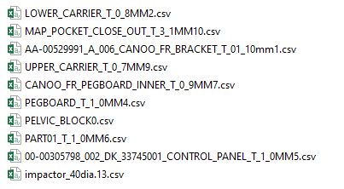
1.5.0 Extract Data.
1.5.1 Extract Data.
Extract Data button collects information useful to the engineer and for the subsequent operation of the automation.
Once user has selected the files of interest – Please click this button to generate data. This operation creates a folder named DATA
In the folder you have kept the result and input files. Please make sure you don’t already have a file named DATA in the folder.
If you are running a second round of report generation in a folder , Please delete the DATA folder or rename it to something else.
File Selector Area
Process status Popup
Proceed to next step, Only after popup window
closes
1.5.2 Generated Files.
Once the Pop Up window closes , You will find that several files are generated at this location. These files contain most information related to stress, strains and displacement of the simulation. It will be a good idea to save it for later reference. The total file sizes are
Very less compared to a result database.
Inside the DATA folder , There will be folders which has names of chosen result files. These folders have csv files which contain element
Ids of each independent part ( not to be confused with component ) , Power users may use this for various purposes.
An Example of a Condensed Stress file.
LOAD_CASE | INCREMENT | COMPONENT_ID | COMPONENT_NAME | MAXIMUM_ID | MAXIMUM_VALUE | COMPONENT_NAME | LOAD_STEP_ITERATION
Loadcase1 | 0.13 | 1 | 00-00305798_002_DK_33745001_CONTROL_PANEL_T_1_0MM | 189948 | 2.1561 | 00305798_002_DK_33745001_CONTROL_PANEL | 1_REN_HHN_DT_ABS_RL1_LH_RT_FDT_BS100_100N_F_1
Loadcase1 | 0.13 | 7 | AA-00529991_A_006_CANOO_FR_BRACKET_T_02_50mm | 216736 | 9.84716 | 00529991_A_006_CANOO_FR_BRACKE | 1_REN_HHN_DT_ABS_RL1_LH_RT_FDT_BS100_100N_F_1
Loadcase1 | 0.07 | 11 | AA-00531969_A_004_CANOO_FR_DECO_STRIP_T_1_0MM | 26822 | 9.82994 | 00531969_A_004_CANOO_FR_DECO_STRIP | 1_REN_HHN_DT_ABS_RL1_LH_RT_FDT_BS100_100N_F_1
Loadcase1 | 0.18 | 25 | AA-00531972_A_005_CANOO_FR_PEGBOARD_ASSEMBLY_T_1_2MM | 4780 | 9.94687 | 00531972_A_005_CANOO_FR_PEGBOARD_ASSEMBLY | 1_REN_HHN_DT_ABS_RL1_LH_RT_FDT_BS100_100N_F_1
Loadcase1 | 0.13 | 47 | CANOO_FR_PEGBOARD_INNER_T_2_5MM | 223455 | 9.54022 | CANOO_FR_PEGBOARD_INNER | 1_REN_HHN_DT_ABS_RL1_LH_RT_FDT_BS100_100N_F_1
Loadcase1 | 0.12 | 52 | LOWER_CARRIER_T_1_0MM | 67464 | 9.64256 | LOWER_CARRIER | 1_REN_HHN_DT_ABS_RL1_LH_RT_FDT_BS100_100N_F_1
Loadcase1 | 0.12 | 81 | MAP_POCKET_CLOSE_OUT_T_3_1MM | 249743 | 0.62143 | MAP_POCKET_CLOSE_OU | 1_REN_HHN_DT_ABS_RL1_LH_RT_FDT_BS100_100N_F_1
Loadcase1 | 0.1 | 85 | PART01_T_1_8MM | 218916 | 3.13556 | PART01 | 1_REN_HHN_DT_ABS_RL1_LH_RT_FDT_BS100_100N_F_1
Loadcase1 | 0.3 | 91 | PEGBOARD_T_1_2MM | 104736 | 4.97783 | PEGBOARD | 1_REN_HHN_DT_ABS_RL1_LH_RT_FDT_BS100_100N_F_1
Loadcase1 | 0.1 | 253000 | PELVIC_BLOCK | 254632 | 0.01987 | PELVIC_BLOCK | 1_REN_HHN_DT_ABS_RL1_LH_RT_FDT_BS100_100N_F_1
Loadcase1 | 0 | 125 | PegBoard_Carrier_Screws_XXSCR | N/A | N/A | PegBoard_Carrier_Screws_XXSCR | 1_REN_HHN_DT_ABS_RL1_LH_RT_FDT_BS100_100N_F_1
Loadcase1 | 0 | 124 | Screw_6m_XXSCR | N/A | N/A | Screw_6m_XXSCR | 1_REN_HHN_DT_ABS_RL1_LH_RT_FDT_BS100_100N_F_1
Loadcase1 | 0.12 | 119 | UPPER_CARRIER_T_2_5MM | 193114 | 9.97503 | UPPER_CARRIER | 1_REN_HHN_DT_ABS_RL1_LH_RT_FDT_BS100_100N_F_1

Slide 8
1.6.0 Register Inputs.
1.6.1 Master Node ID.
Entry of Master node ID is optional . Master node ID of the constrain equation element connected to Load application entity is 1001 as per methodology . If the input file and result database follow the defined rules, There is no need to enter the Master Node ID.
Displacement ,Force or any output that need drawing of a curve in Load master page is to be defined in output block with this ID.
If the master node has a different number in the input and output files , It can be typed to the Box given. But it is highly recommended that the methodology is followed by engineers.
1.6.2 Accepted output Quantities.
Entry of Master node ID is optional . Master node ID of the constrain equation element connected to Load application entity is 1001 as per methodology . If the input file and result database follow the defined rules, There is no need to enter the Master Node ID.
Displacement ,Force or any output that need drawing of a curve in Load master page is to be defined in output block with this ID.
If the master node has a different number in the input and output files , It can be typed to the Box given. But it is highly recommended that the methodology is followed by engineers.
The Force and Displacement request for PAMCRASH must be defined as IMPACTOR_TRIM_CONTACT. Other Names are not supported.
Output Entry accepted for Load curve
OUTPUT | ABAQUS | PAMCRASH | LS-DYNA
DISPLACEMENT | Displacement | Node (Time History) | Displacement
FORCE | CF-Point loads | Contact Variables (Time History) | discrete/nodes
FORCE COMPONENT | MAG | Contact_Force-Magnitude | resultant_force
DISPLACEMENT COMPONENT | MAG | Translational_Displacement-Magnitude | Mag
FORCE REQUEST | N1001 | IMPACTOR_TRIM_CONTACT | N1001
DISPLACEMENT REQUEST | N1001 | IMPACTOR_TRIM_CONTACT | N1001
1.6.3 Accepted Output Formats.
List of accepted output formats are given below.
Dyna input files are to be in DYN format, If not please rename to DYN format before launching the automation.
OUTPUT | ABAQUS | PAMCRASH | LS-DYNA
INPUT FORMAT | INP | PC | DYN
FIELD OUTPUT | ODB | ERFH5 | D3PLOT
TIME HISTORY | ODB | ERFH5 | BINOUT0000
1.6.4 Unsupported Input and Output Formats.
DSY and THP format outputs for Pamcrash are not supported. Please make sure Pamcrash outputs are in ERFH5 format.
Dyna master input files cannot have a key extension.

Slide 9
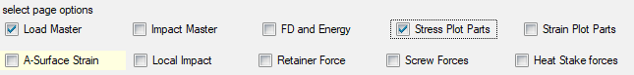
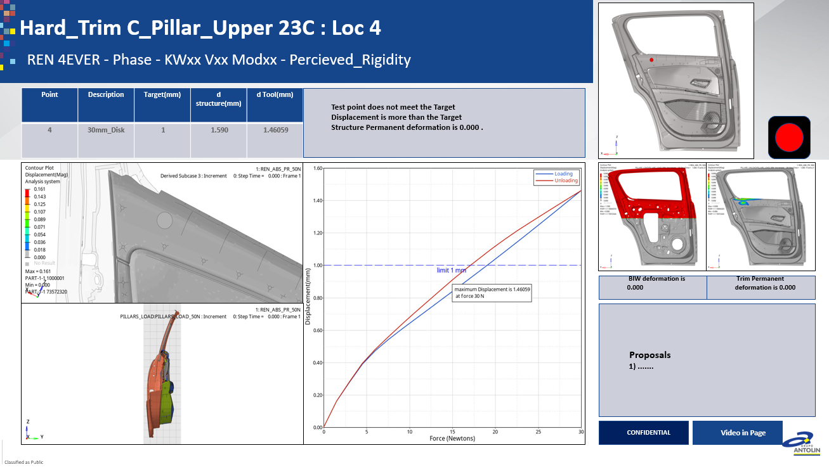
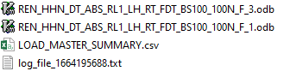
1.7.0 Load Files to Format.
1.7.1 Loading files to specific formats.
Once the Process status popup closes, The format selection is ready to launch . Please choose the appropriate formats applicable for the report to be made. Check the Boxes adjacent to description of the formats. Please take care not to select conflicting formats or formats not compatible with the result output.
It is important to make sure that Hyperview can successfully load the input files also, Not just the output files. The include structure and corresponding folders are to be placed correctly .
Format selection Area
Process status Popup
1.7.2 Load Master Page.
The Load master Page provides a format for reporting stiffness related load cases. It provides displacement ,section animations and a force displacement curve for loading and unloading.
User has the option to have F-D or D-F curve.
By default the application plots Displacement vs force. By checking The Force- Disp check button, This can be reversed. The same applies for Angle moment as well.
A sample output presentation file is provided at the automation folder in PUNCAE.
DISPLACEMENT
SECTION
DISPLACEMENT VS FORCE
1.7.3 Load Master Summary
The Load master summary writes out important information from the results . This information can be copied to report summary page. Information about impactor coordinates, Maximum displacement, permanent deformation etc. are recorded. A sample summary file is provided at
\\punnscaddata01\PUN_CAE\2022\20.AUTOMATION_AI
1.7.4 Load master page - Dependencies
Many values of Headings and Tables are derived from the load code and Part code files mentioned in 1.4.3.
If information printed in PowerPoint does not match with the contents of your input file or result file name , Please update the contents of the Load code and Part code files as mentioned in section 1.4.3 of the document.

Slide 10
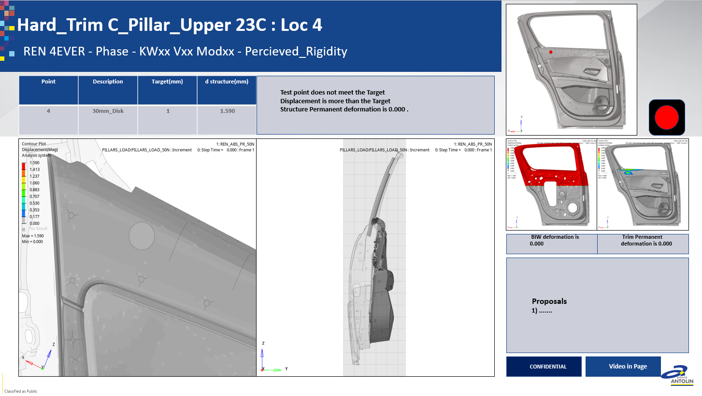
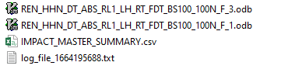
1.7.0 Load Files to Format.
1.7.5 Impact Master Page.
The Impact master Page provides a format for reporting Animations and displacement data for Impact related load cases. The BIW deformations and Trim Permanent deformation is reported on left side of the Page. This page is active for Abaqus, Pamcrash and LS-Dyna .
DISPLACEMENT
SECTION
1.7.6 Impact Master Summary
The Impact master Page provides a format for reporting Animations and displacement data for Impact related load cases. The BIW deformations and Trim Permanent deformation is reported on left side of the Page. This page is active for Abaqus, Pamcrash and LS-Dyna .
1.7.7 Impact master page - Dependencies
Many values of Headings and Tables are derived from the load code and Part code files mentioned in 1.4.3.
If information printed in PowerPoint does not match with the contents of your input file or result file name , Please update the contents of the Load code and Part code files as mentioned in section 1.4.3 of the document.

Slide 11
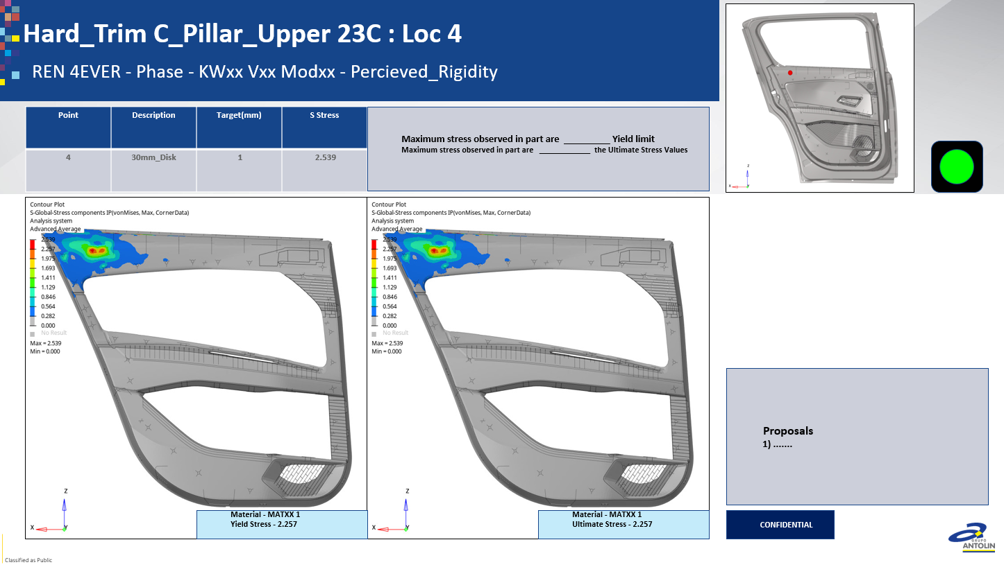
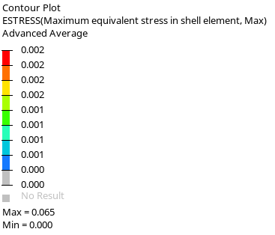
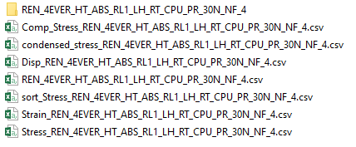
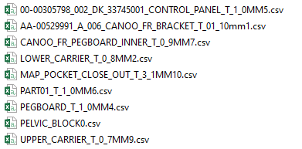
1.7.0 Load Files to Format.
1.7.8 Stress Plot Parts.
The Stress Plot Page Records the Vonmises stress for each part in the assembly. The actions required for selection of parts are
Explained in next paragraph.
Window 1 - Update the second value in legend as Yield stress
Window 2 - Update the second value in legend as Ultimate stress
The values updated here will show up in the summary table file.
STRESS-YIELD
STRESS-ULTIMATE
1.7.9 Selection of required parts for Stress Plot .
The Automation can identify each independent part in the assembly. Details of such parts are written in Data folder in directories named after output files. Users can open those folders and delete the csv files corresponding to parts which are not to be used for plot generation.
An example is given below. Here only first two files are retained, Rest of the files are deleted. This means Parts stress, Parts strain and A-surface strain plots will be generated for these two parts only. Please ignore the thickness in the name, The components correspond to
Remaining part of naming.
Delete the files that correspond To Part names that are not to be Included in the Partwise stress Plots.
In the example , Plots will be made For parts corresponding to first two Files.
Do this for other results files by selective
Deletion of files from respective folders
1.7.10 Stress Data Types and Data components .
The Table given below explains the types of Data components that will be used for Stress plots. If users need to use a different quantity
Please contact the methodology department in advance before project commence.
It is recommended that this data is converted to a dynamic input for subsequent revisions of Automation.
Table of reported Stress Entry
SOLVER | CONTOUR | DATA TYPE | DATA COMPONENT
ABAQUS | STRESS | vonMises | S-Global-Stress components IP
LS-DYNA | STRESS | Stress | vonMises
PAMCRASH | STRESS(2D) | ESTRESS | Maximum equivalent stress in shell element
 | STRESS(3D) | SXYZ/3D/Stress | vonMises
1.7.11 Stress Plot Parts - Dependencies
User Many values of Headings and Tables are derived from the load code and Part code files mentioned in 1.4.3.
If information printed in PowerPoint does not match with the contents of your input file or result file name , Please update the contents of the Load code and Part code files as mentioned in section 1.4.3 of the document.

Slide 12
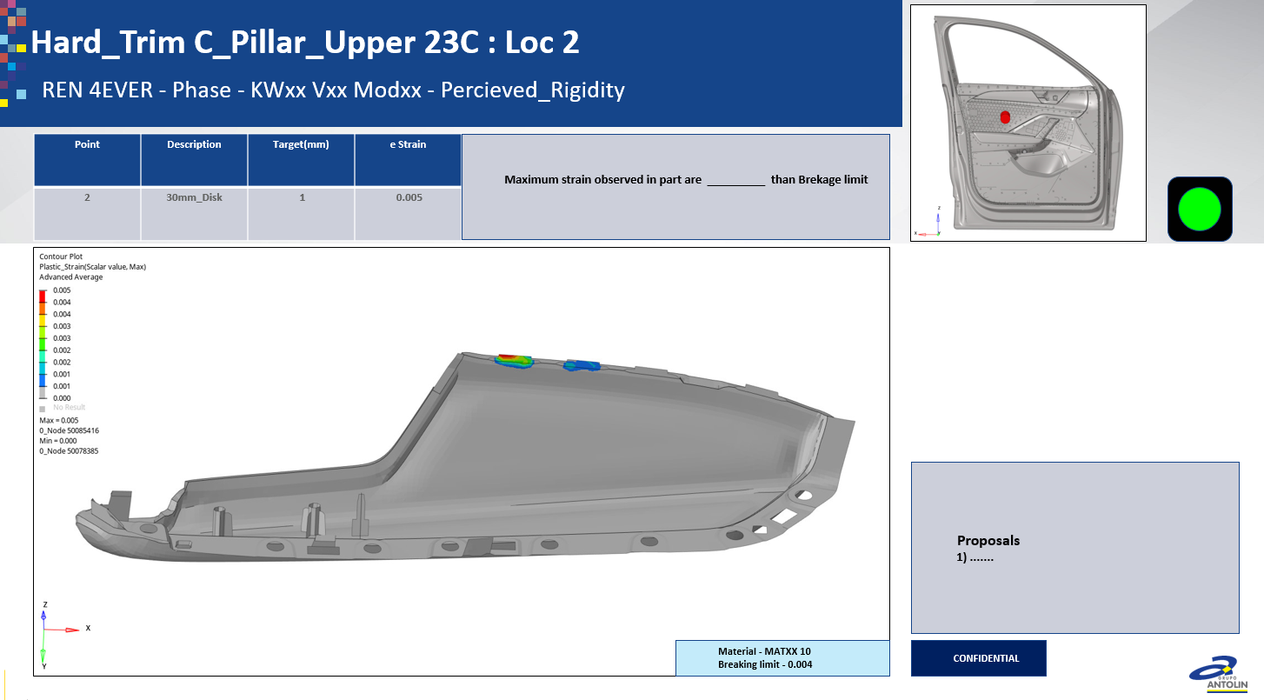
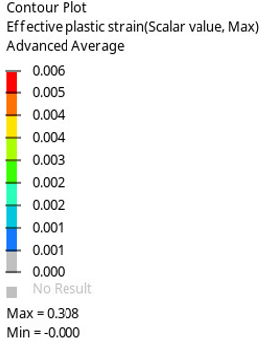
1.7.0 Load Files to Format.
1.7.12 Strain Plot Parts.
The Strain Plot Page Records the Plastic strains for each part in the assembly. The actions required for selection of parts are
Explained in next paragraph.
Window 1 - Update the breaking strain value in legend
The values updated here will show up in the summary table file.
BREAKING STRAIN
1.7.13 Selection of required parts for Strain Plot .
The Automation can identify each independent part in the assembly. Details of such parts are written in Data folder in directories named after output files. Users can open those folders and delete the csv files corresponding to parts which are not to be used for plot generation.
An example is given below. Here only first two files are retained, Rest of the files are deleted. This means Parts stress, Parts strain and A-surface strain plots will be generated for these two parts only. Please ignore the thickness in the name, The components correspond to
Remaining part of naming.
Delete the files that correspond To Part names that are not to be Included in the Partwise stress Plots.
In the example , Plots will be made For parts corresponding to first two Files.
Do this for other results files by selective
Deletion of files from respective folders
1.7.14 Strain Data Types and Data components .
The Table given below explains the types of Data components that will be used for Stress plots. If users need to use a different quantity
Please contact the methodology department in advance before project commence.
It is recommended that this data is converted to a dynamic input for subsequent revisions of Automation.
Table of reported Strain Entry
SOLVER | CONTOUR | DATA TYPE | DATA COMPONENT
ABAQUS | STRAIN | vonMises | PE-Global-Plastic strain components IP
LS-DYNA | STRAIN | Stress | vonMises
PAMCRASH | STRAIN(2D) | EPLE/2D | Scalar value
 | STRAIN(3D) | EPLE/3D/Equivalent Plastic Strain | Scalar value

Slide 13
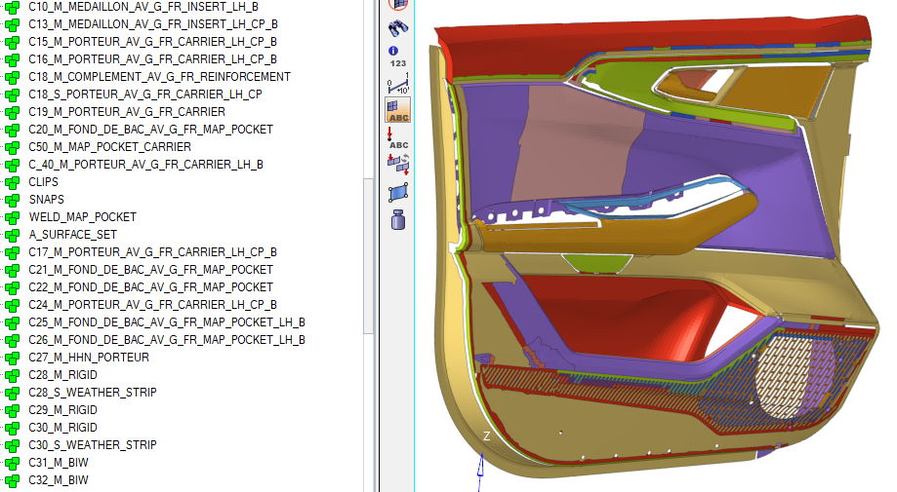
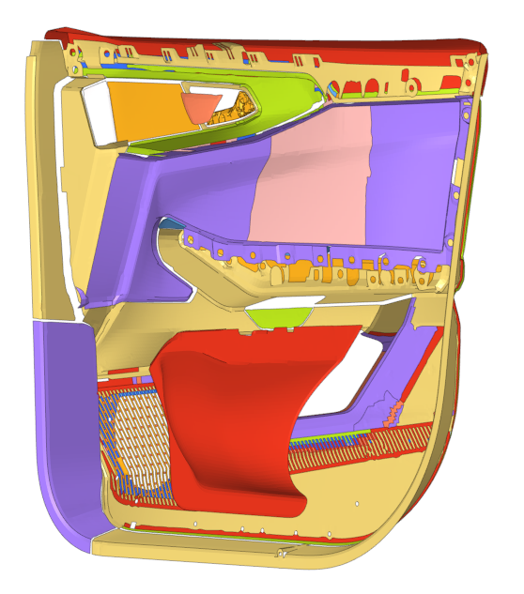
1.7.0 Load Files to Format.
1.7.15 A-Surface Strain Plot Parts.
The A-Surface Strain Plot Page Records the Plastic strains for A-Surface of each part in the assembly. The actions required for selection of parts are Explained in next paragraph.
Window 1 - Update the breaking strain value in legend
The values updated here will show up in the summary table file.
BREAKING STRAIN
Example of an A-Surface strain set is given below.
Avoid selecting Areas like this.
This surface is not Part of A-Surface.
1.7.16 Selection of required parts for Strain Plot .
The Automation can identify each independent part in the assembly. Details of such parts are written in Data folder in directories named after output files. Users can open those folders and delete the csv files corresponding to parts which are not to be used for plot generation.
An example is given below. Here only first two files are retained, Rest of the files are deleted. This means Parts stress, Parts strain and A-surface strain plots will be generated for these two parts only. Please ignore the thickness in the name, The components correspond to
Remaining part of naming.
Delete the files that correspond To Part names that are not to be Included in the Partwise stress Plots.
In the example , Plots will be made For parts corresponding to first two Files.
Do this for other results files by selective
Deletion of files from respective folders
1.7.17 Strain Data Types and Data components .
The Table given below explains the types of Data components that will be used for Stress plots. If users need to use a different quantity
Please contact the methodology department in advance before project commence.
It is recommended that this data is converted to a dynamic input for subsequent revisions of Automation.
Table of reported Strain Entry
SOLVER | CONTOUR | DATA TYPE | DATA COMPONENT
ABAQUS | STRAIN | vonMises | PE-Global-Plastic strain components IP
LS-DYNA | STRAIN | Stress | vonMises
PAMCRASH | STRAIN(2D) | EPLE/2D | Scalar value
 | STRAIN(3D) | EPLE/3D/Equivalent Plastic Strain | Scalar value

Slide 14
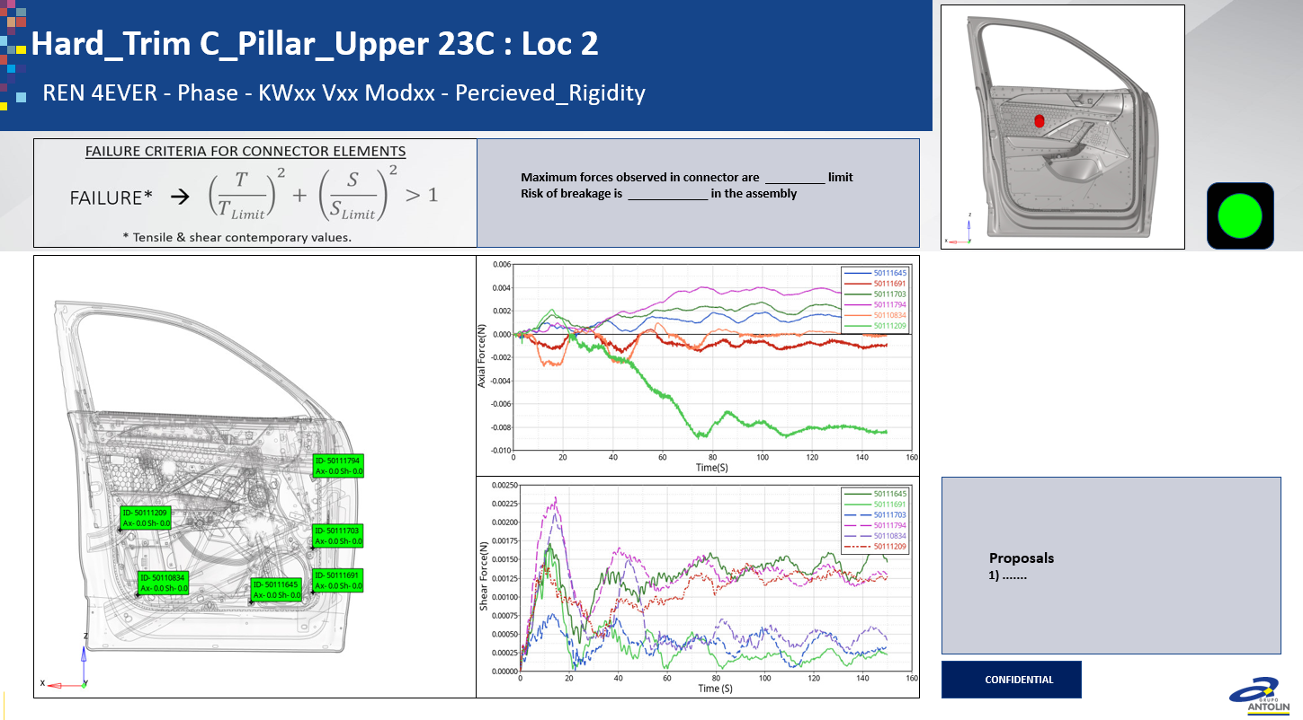
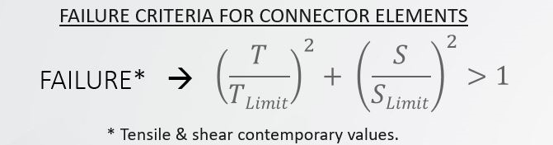
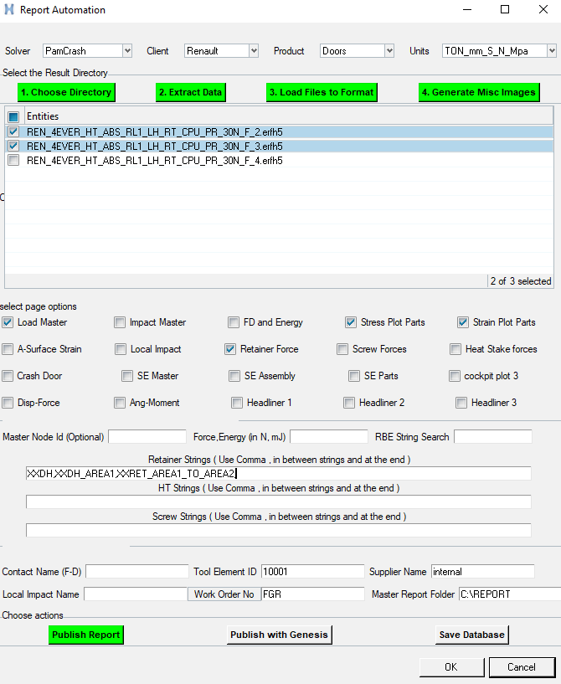
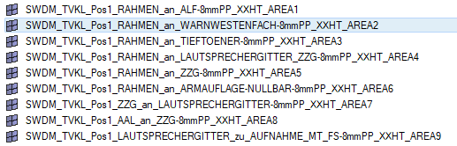
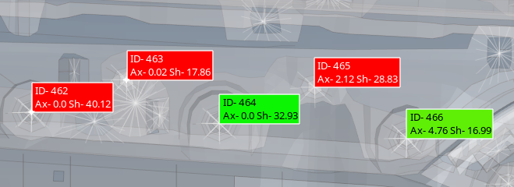
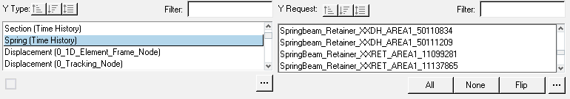
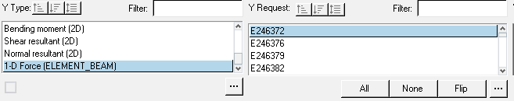
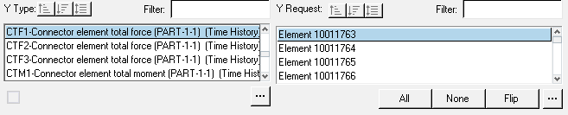
1.7.0 Load Files to Format.
1.7.18 Retainer Force Plot .
The Retainer force Plot Page Records the Axial force and Shear force values from the result data for components of relative motion present in the model. There are few naming rules defined for connector parts to achieve this.
RETAINER | _XXRET_
SCREW | _XXSCR_
HEAT STAKE | _XXHT_
AXIAL FORCE
BREAKING STRAIN
SHEAR FORCE
1.7.19 Selection of required connectors for Retainer force Plot .
Different types of connectors are to have specific strings in their component names. The user has the freedom to use strings of their choice to differentiate different connector groups , Such sets are useful to group connectors specific to two parts or an area.
User need not enter full names of such a group, Only a unique portion is required. For example XXHT_AREA4
EXAMPLE FOR CONNECTOR NAMING
SPECIFYING FAILURE
If a connector fails at 20N in axial and 15N in shear ,please add _AXFVAL_20_SHFVAL_15
To the component name of the connector.
The units are always in N, Automation will convert it to your system of choice.
Example -CONNECTOR_WELD_CARRIER_INSERT_TOP_ROLL_XXHT_AREA4_AXFVAL_20_SHFVAL_15
Text area to enter additional specific connector groups
XXDH,XXDH_AREA1,XXRET_AREA1_TO_AREA2,
Failed connector elements will be highlighted in Red.
Others in Green Color
Output Example for Hyper view - PAMCRASH
Here element ID is auto added by Pamcrash –Not to enter by user
THELE / 0
NAME SWRP_TVKL_Pos1_RAHMEN_an_INSERT-15mmPP_XXHT_AREA21
ELE 50080929 50080964 50080995
END
Output Example for Hyper view - LSDYNA
*DATABASE_HISTORY_BEAM
$HMNAME OUTPUTBLOCKS 1Screws
$ ID ID ID ID ID ID ID ID
246740 246372 246376 246379 246382 246385 246429 246462
Output Example for Hyper view - ABAQUS
*OUTPUT, HISTORY, TIME INTERVAL = 0.0
*ELEMENT OUTPUT, ELSET = CONNECTOR_OP, VARIABLE = XX

Slide 15
1.7.0 Load Files to Format.
1.7.20 Screw Force Plot .
The Retainer force Plot Page Records the Axial force and Shear force values from the result data for components of relative motion present in the model. There are few naming rules defined for connector parts to achieve this.
RETAINER | _XXRET_
SCREW | _XXSCR_
HEAT STAKE | _XXHT_
AXIAL FORCE
BREAKING STRAIN
SHEAR FORCE
1.7.21 Selection of required connectors for Screw force Plot .
Different types of connectors are to have specific strings in their component names. The user has the freedom to use strings of their choice to differentiate different connector groups , Such sets are useful to group connectors specific to two parts or an area.
User need not enter full names of such a group, Only a unique portion is required. For example XXHT_AREA4
EXAMPLE FOR CONNECTOR NAMING
SPECIFYING FAILURE
If a connector fails at 20N in axial and 15N in shear ,please add _AXFVAL_20_SHFVAL_15
To the component name of the connector.
The units are always in N, Automation will convert it to your system of choice.
Here is an example.
CONNECTOR_WELD_CARRIER_INSERT_TOP_ROLL_XXHT_AREA4_AXFVAL_20_SHFVAL_15
Text area to enter additional specific connector groups
XXDH,XXDH_AREA1,XXRET_AREA1_TO_AREA2,
Output Example for Hyper view - PAMCRASH
Here element ID is auto added by Pamcrash –Not to enter by user
THELE / 0
NAME SWRP_TVKL_Pos1_RAHMEN_an_INSERT-15mmPP_XXHT_AREA21
ELE 50080929 50080964 50080995
END
Output Example for Hyper view - LSDYNA
*DATABASE_HISTORY_BEAM
$HMNAME OUTPUTBLOCKS 1Screws
$ ID ID ID ID ID ID ID ID
246740 246372 246376 246379 246382 246385 246429 246462
Output Example for Hyper view - ABAQUS
*OUTPUT, HISTORY, TIME INTERVAL = 0.0
*ELEMENT OUTPUT, ELSET = CONNECTOR_OP, VARIABLE = XX

Slide 16
1.7.0 Load Files to Format.
1.7.22 Heat Stake Force Plot .
The Retainer force Plot Page Records the Axial force and Shear force values from the result data for components of relative motion present in the model. There are few naming rules defined for connector parts to achieve this.
RETAINER | _XXRET_
SCREW | _XXSCR_
HEAT STAKE | _XXHT_
AXIAL FORCE
BREAKING STRAIN
SHEAR FORCE
1.7.23 Selection of required connectors for Heat Stake force Plot .
Different types of connectors are to have specific strings in their component names. The user has the freedom to use strings of their choice to differentiate different connector groups , Such sets are useful to group connectors specific to two parts or an area.
User need not enter full names of such a group, Only a unique portion is required. For example XXHT_AREA4
EXAMPLE FOR CONNECTOR NAMING
SPECIFYING FAILURE
If a connector fails at 20N in axial and 15N in shear ,please add _AXFVAL_20_SHFVAL_15
To the component name of the connector.
The units are always in N, Automation will convert it to your system of choice.
Here is an example.
CONNECTOR_WELD_CARRIER_INSERT_TOP_ROLL_XXHT_AREA4_AXFVAL_20_SHFVAL_15
Text area to enter additional specific connector groups
XXDH,XXDH_AREA1,XXRET_AREA1_TO_AREA2,
Output Example for Hyper view - PAMCRASH
Here element ID is auto added by Pamcrash –Not to enter by user
THELE / 0
NAME SWRP_TVKL_Pos1_RAHMEN_an_INSERT-15mmPP_XXHT_AREA21
ELE 50080929 50080964 50080995
END
Output Example for Hyper view - LSDYNA
*DATABASE_HISTORY_BEAM
$HMNAME OUTPUTBLOCKS 1Screws
$ ID ID ID ID ID ID ID ID
246740 246372 246376 246379 246382 246385 246429 246462
Output Example for Hyper view - ABAQUS
*OUTPUT, HISTORY, TIME INTERVAL = 0.0
*ELEMENT OUTPUT, ELSET = CONNECTOR_OP, VARIABLE = XX

Slide 17
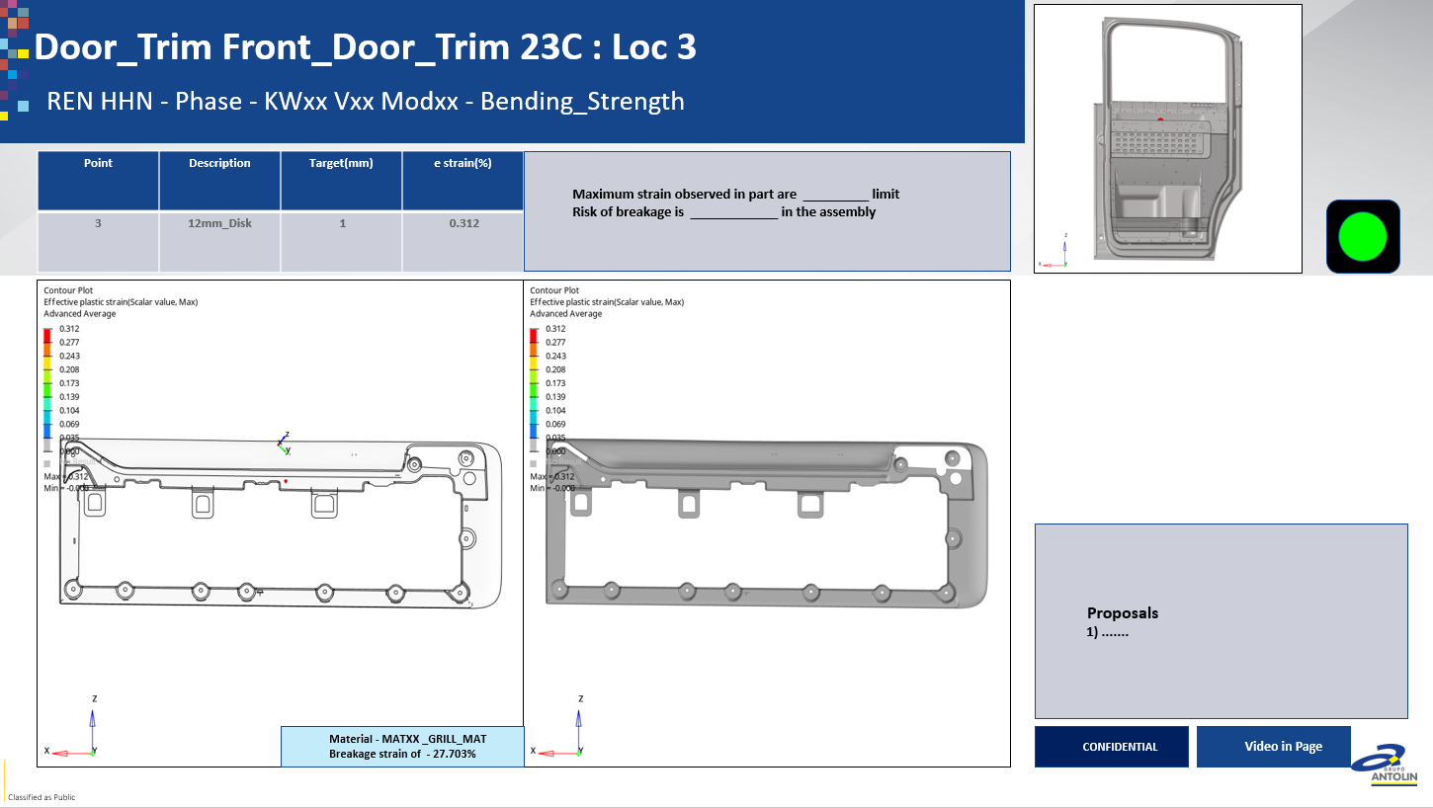
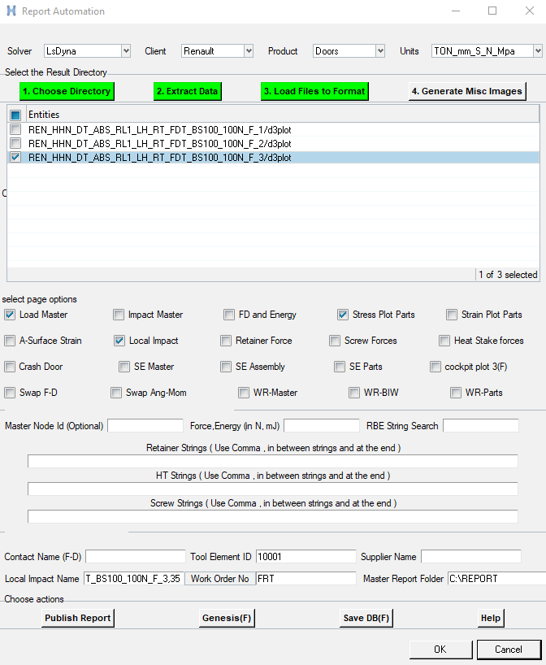
1.7.0 Load Files to Format.
1.7.24 Local Impact Master Page.
The Local impact page can report an impact area of interest. An example is example speaker grill. An ISO plastic strain plot and Plastic strain plot are generated for the component ID provided.
DISPLACEMENT
SECTION
BREAKING STRAIN
BREAKING STRAIN
1.7.25 Local Impact page Input.
Choose the local Impact page format. It is mandatory to Fill the Local Impact Name . The input file which needs local impact among the list followed by comma and the component ID needs to be filled in .
Component name as per input files is valid.
Examples are given below for supported solvers.
Only the input file and component specified will be considered for the plot generation. Currently multiple files cannot be specified.
LSDYNA- REN_HHN_DT_ABS_RL1_LH_RT_FDT_BS100_100N_F_3,35
Abaqus -REN_4EVER_HT_ABS_RL1_LH_RT_CPU_SR_150N_F_1.odb,10000292
Pamcrash - REN_4EVER_HT_ABS_RL1_LH_RT_CPU_SR_150N_F_1.erfh5,101
1.7.26 Local Impact page - Dependencies
Local impact page is currently not tested for Pamcrash.
There is a requirement of proper input file loading for generation of local impact page. If the input file is not loaded properly to hyper view due to improper include structure or due to parameters present in the input files , Local impact page will not be generated.
Please let the methodology team in advance – When there is a requirement of local impact plot generation for PamCrash solver.
Value specified at #spot 2 will be printed in CAE report
As Breaking strain

Slide 18
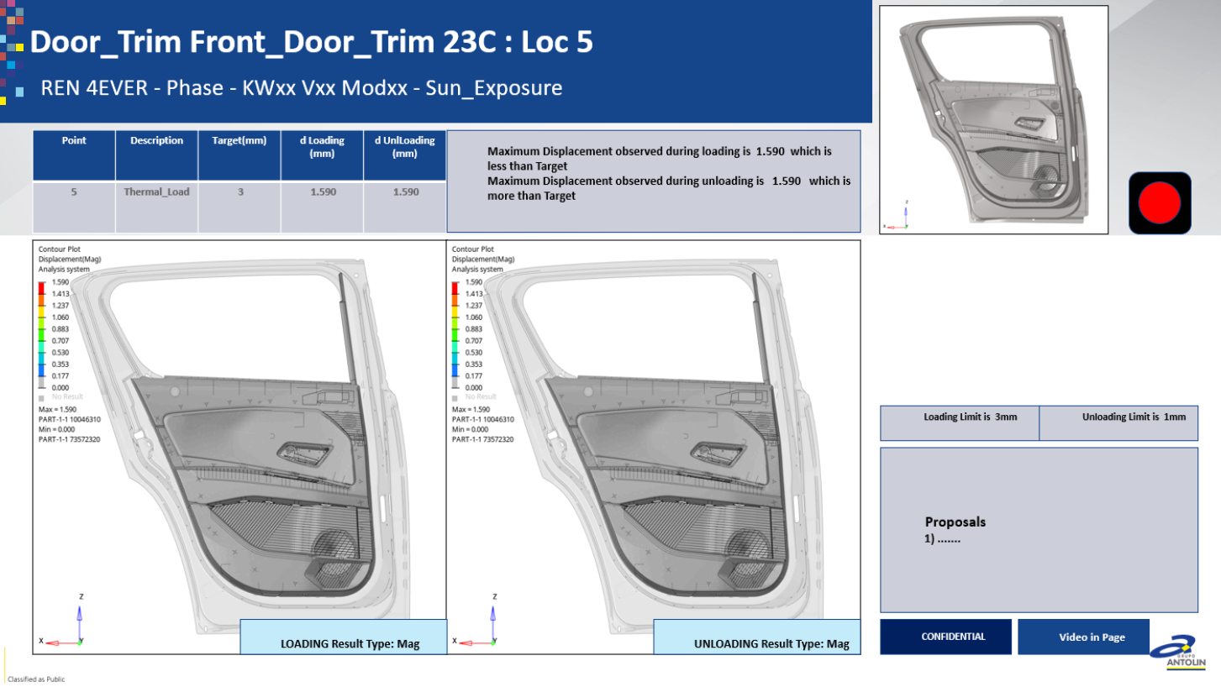
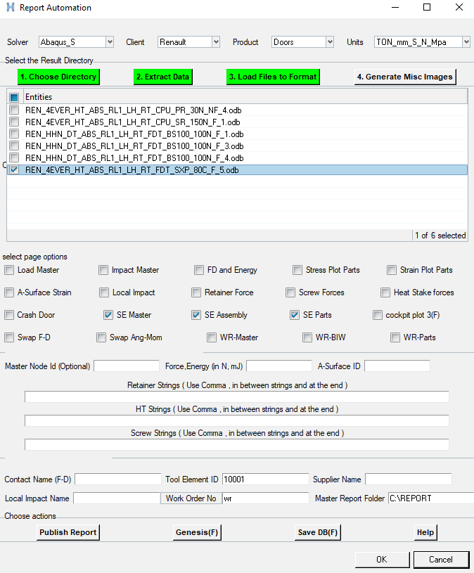
1.7.0 Load Files to Format.
1.7.27 Sun Exposure Master Page.
The Sun exposure master page generates two windows ,Both of which are Displacement magnitude animations. First window records loading load step and second window records unloading step.
LOADING- DISPLACEMENT
UNLOADING- DISPLACEMENT
1.7.28 Sun Exposure Input.
Choose the Sun exposure master ,Sun exposure assembly and Sun exposure parts selection boxes .
The other inputs required are work order number and report folder input.
1.7.29 Sun Exposure Summary Table.
Summary of Sun Exposure is generated on the folder containing result files. Summary table records displacement outputs of
Assembly , and Part files chosen.
1.7.30 Sun Exposure - Dependencies
Sun Exposure is supported for Abaqus Solver only.
Master Node id and Tool element numbering is irrelevant for sun exposure page.
Type of displacement is printed here

Slide 19
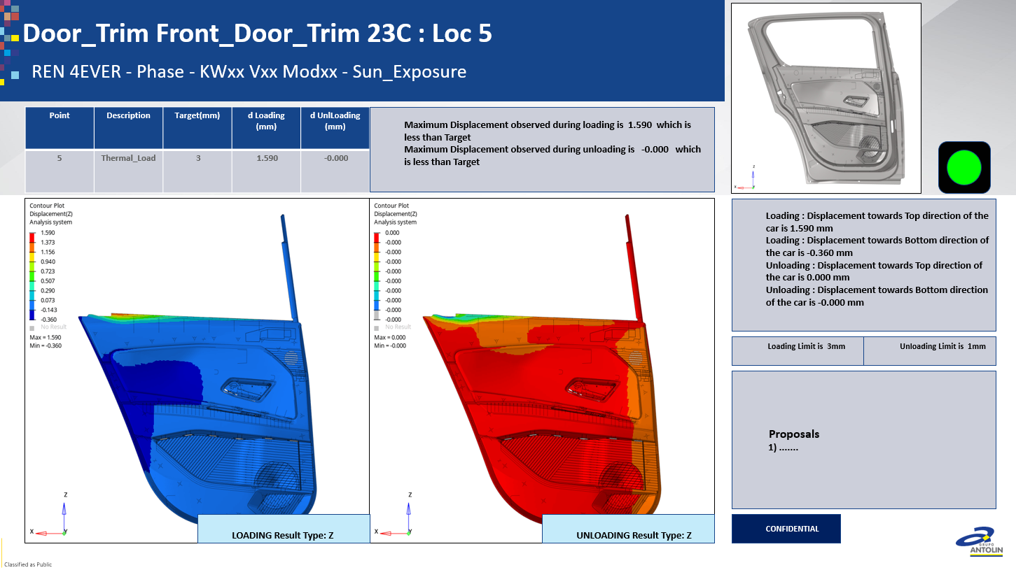
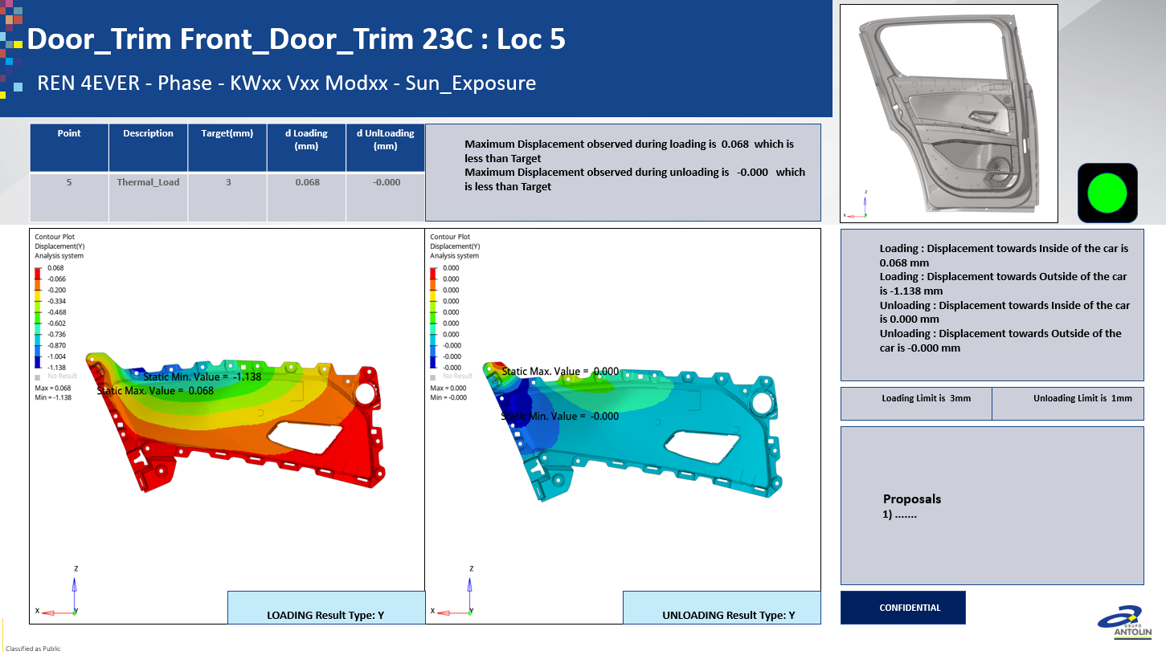
1.7.0 Load Files to Format.
1.7.32 Sun Exposure Assembly Page.
The Sun exposure Assembly page generates 4 Pages. Displacement Magnitude followed by Displacements in Global X,Y and Z for the complete assembly .
The application will Hide components with the following strings present in component names ( Caps or small caps).
BIW, FAKE,SEAL,NULL,SHEET,PATCH.
Currently the Automatic displacement summary is printed for LH side only.
DISPLACEMENT
SECTION
BREAKING STRAIN
BREAKING STRAIN
1.7.32 Sun Exposure Parts Page.
If Sunexposure Parts are chosen four pages each will be generated for every parts selected by the mechanism given below.
The Pages are displacement magnitude , X, Y and Z plots.
Left side window records the loading values and right side window records the unloading values.
1.7.33 Selection of required parts for Sun Exposure Page .
The Automation can identify each independent part in the assembly. Details of such parts are written in Data folder in directories named after output files. Users can open those folders and delete the csv files corresponding to parts which are not to be used for plot generation.
An example is given below. Here only first two files are retained, Rest of the files are deleted. This means Sun Exposure parts plots will be generated for these two parts only. Please ignore the thickness in the name, The components correspond to
Remaining part of name.
Delete the files that correspond To Part names that are not to be Included in the Partwise stress Plots.
In the example , Plots will be made For parts corresponding to first two Files.
Do this for other results files by selective
Deletion of files from respective folders

Slide 20
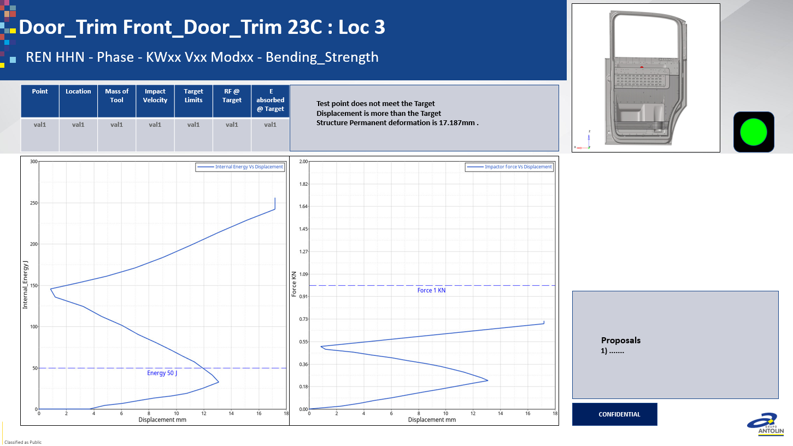
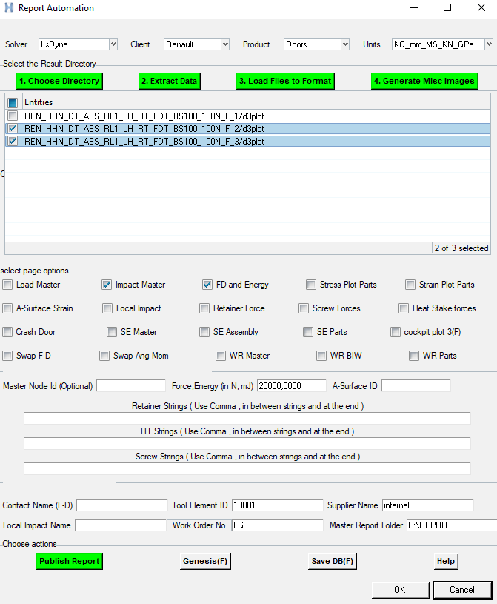
1.7.0 Load Files to Format.
1.7.34 FD and Energy Page.
FD and Energy Page generates Internal energy Vs Displacement plot in Window 1 and Force vs Displacement plot on window 2.
At present this page supports LSDYNA and PAMCRASH.
If this page is required for Abaqus – Please contact methodology department.
IE vs DISP
FORCE vs DISP
1.7.35 FD and Energy Page input.
Select the FD and Energy page tick box . There is a mandatory requirement to enter the limits for force and internal energy.
The units for entry are N and mJ.
Even if the unit system of your model is a different one , Stick with the system mentioned here for FD and Energy entry.
Choosing the overall general unit system will automatically convert the limit values to model unit system.
Type in contact name , if there is a deviation from
IMPACTOR_TRIM_CONTACT

Slide 21
1.7.0 Generate Misc Images.
1.7.34 FD and Energy Page.
FD and Energy Page generates Internal energy Vs Displacement plot in Window 1 and Force vs Displacement plot on window 2.
At present this page supports LSDYNA and PAMCRASH.
If this page is required for Abaqus – Please contact methodology department.
IE vs DISP
FORCE vs DISP
1.7.35 FD and Energy Page input.
Select the FD and Energy page tick box . There is a mandatory requirement to enter the limits for force and internal energy.
The units for entry are N and mJ.
Even if the unit system of your model is a different one , Stick with the system mentioned here for FD and Energy entry.
Choosing the overall general unit system will automatically convert the limit values to model unit system.
Type in contact name , if there is a deviation from
IMPACTOR_TRIM_CONTACT

Slide 22
1.7.0 Open Topics.
1) FD and Energy Page for Abaqus Solver.
CAE team to inform methodology team when an FD-Energy curve needs to be generated for Abaqus solver.
Pending due to unavailability of proper input and output files.
2) A-Surface Strain for LS-Dyna solver does not work on the workshop data set.
CAE team to inform methodology team when an A –Surface plot need to be generated for Dyna solver.
Pending due to unavailability of proper input and output files.
3) A-Surface strain for Pam Crash Solver
CAE team to inform methodology team when an A –Surface plot need to be generated for PamCrash solver.
Pending due to unavailability of proper input and output files compatible with Hyper view.
4) Local Impact for Pam Crash solver.
CAE team to inform methodology team when a Local Impact need to be generated for PamCrash solver.
Pending due to unavailability of proper input and output files compatible with Hyper view.
5) Torque load case.
CAE team to inform methodology team when an torque curve needs to be generated for any solver.
Pending due to unavailability of proper input and output files.

